Slide 1
Technological Advances in Clinical Trial Conduct: CCTG Perspective
August 5, 2022
Lam Pho, Chief Information Officer

Slide 2
Learning Objectives
To review the current advancements in technologies for CCTG clinical trial conduct
Review examples such as mobile apps (SymptomIQ and SPROUT) for real-time patient self-reporting, and eConsent
To review the future direction of technologies at CCTG
Define Data Analytics and Visualization, review examples of future development including our patient portal, and platforms for data analytics and visualizations

Slide 3
Information Technology at CCTG
Safety Monitoring & Engagement
IT Infrastructure & Administration
SAE & Safety Reporting & Reminders
e-Assessment System
Pharmacovigilance
Reporting to Regulatory & Partners
CIOMS, PDF, XML
Electronic Data Capture
CCTG Data Integrated Platform
CCTG Data Centre & Storage Facilities
Database Encryption At-Rest & In-Transit
CAS Single Sign-On
Cybersecurity Baseline Controls
Cloud Network Services
SAS Data Checking & Analysis
Help Desk Support & Change Management
Financial Management & Site/Trial/Per Case Funding
Safety Monitoring & Reporting
IT Infrastructure & Administration
Site Monitoring & Reporting
Comprehensive eTMF Solution
Accrual Utility
Trial & Site Management
Centre Performance Index
Central Office Monitoring
Data Checking System
On-Site Monitoring
Audit Database
Regulatory
& Safety
Data
Collection
Tissue & Imaging
Site Monitoring & Audit
Omics
Patient Enrollment, Scheduling & Tracking
Training & Assessments
Mango: Central Enrollment & Credentialing System, Drug Distribution, Tracking & Management
Molecular Tumour Board Review
CRF Scheduling & Reminders
Supporting Document Upload
CRF Tracking, Review Status, & Metrics
Regulatory & Trial Management
Patient Engagement
RIPPLE: Account Management & Trial Delegation Log
Membership Roster
Ethics Tracking & Reminders
Regulatory Documents
Radiotherapy Site Credentialing
Trial Webpage
Protocol, Consent & Amendment Management
Data Management Materials & Manuals
Oversight
Support
Regulatory & Trial Management
Patient Enrollment
Scheduling & Tracking
Data Sharing & Visualization
Electronic Data Capture
iMedidata Rave EDC, REDCap EDC
CDISC Compliant eCRF Templates
Serious Adverse Events
Central Lab Tracking
Radiotherapy QA Central Review
Training and Assessments
Data Sharing & Visualization
Tissue & Imaging
Omics
EDC e-Learning
GCP & Health Canada Division 5
STU: Site Training Utility
CCTG Supplementary Training
CCTG Document Management & Training
Data Visualizations & BI Dashboard
Utilize External Data Platforms (i.e. OHDP) for eSource EMR/EHR
Collaborative Data Sharing & Linkage Across Network Partners
CCTG Data Sharing Platform
LETTUCE: Electronic Tissue Tracking
Specimen & Image Collection & Tracking
CAR-t Cell Tracking & Linkage
Digitalize Tissue Imaging/records
Raw Data & Results
Patient Engagement
Multi-platform ePRO, eCOA
eConsent
Patient-Centric Platform/Portal
Notes: Some are new/planned initiatives

Slide 4
CCTG Digital Transformation
Digital transformation is the adoption of digital technology by an organization. Common goals for its implementation are to improve efficiency, value or innovation
CCTG Digital Transformation Strategy
Mobile applications, wearables, biosensors, connected devices
Automation & Platforms
Cognitive Technologies
Data Analytics & Visualizations
Data Science
Digital Approach Areas of Focus: Trial Start Up, Trial Conduct, Trial Closure, and Trial Analysis
Today’s presentation focus on:
Mobile App Technology
eConsent
Patient Portal
Data Analytics & Visualizations

Slide 5
CCTG Patient Platform
Web-based portal
Patients register & maintain a user profile
Learn about new trials
Register for potential trials
Link to eCOA, ePRO, eConsent information and actions
Includes all patient clinical trial activities into a single user interface
Patient
Portal
CCTG Patient
Platform
eConsent
View and complete required study consent forms
Protocol compliance
Electronic signatures
Version control
Responsive web applications and native mobile apps
View and complete required modules (e.g. questionnaires, forms)
Electronic data submitted in real-time, available for patient, site, sponsor
Receive notifications and reminders for required actions
eCOA &
ePRO

Slide 6
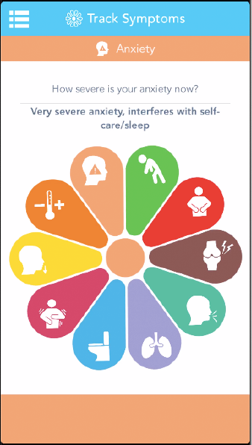
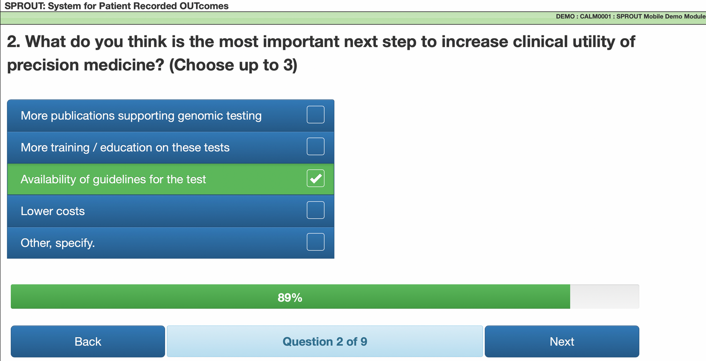
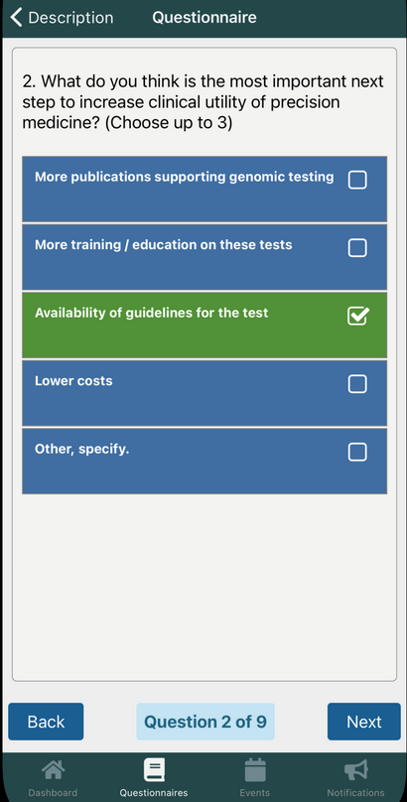
Mobile App Technology
e-PRO using in-house developed mobile-friendly web application SPROUT (System for Patient Recorded Outcomes)
BL13.F is piloting the use of uMotif’s mobile health app Symptom-IQ on BL.13 for subject’s self-tracking of symptoms for adverse event reporting
CCTG eCOA
&
ePRO
Currently developing SPROUT as a true native mobile app (for iOS and Android)

Slide 7
Mobile App Technology
Further investigate use of mobile app technology for self-tracking and real-time reporting by trial subjects
Broaden in-house expertise and training on mobile app development and workflows
Investigate mobile app for supporting trial conduct for patients, alerts/reminders to enhance adherence to protocol, medication compliance, health promotion and disease prevention, health and disease monitoring, communication, data collection, mobile telemedicine, point of care and medical decision support, emergency medical response
Mobile app for patients and sites/investigators, portal for sites/investigators and central office/monitoring
Patient-focused apps
Emphasis on design, optimize usability of app and device, multi-lingual support

Slide 8
Mobile App Technology (cont’d)
Benefits
Patient engagement
Real-time data
Cost saving in site administration
Challenges
Data security, privacy and PHI concerns
System integration, operating systems, cost of providing mobile devices, network connection
Potential for bias in reporting

Slide 9
eConsent
“eConsent” is an informed consenting method that uses multimedia components (e.g. videos, interactive presentations) to further explain the benefits and risks of participating in a clinical trial
Easy to understand
Engaging and interactive
CCTG is currently using electronic patient consent (eConsent) for SC.27 using the REDCap EDC system

Slide 10
eConsent (cont’d)
Further investigate adoption of e-Consent to facilitate ease and reduce burden of trial participation
Determine scope and types of e-consent, languages; informed consent form for trial, collection of information related to tissue, pregnancy, exposure to investigational agents
Identify, review, and address regulatory concerns (including FDA 21 CFR Part 11 for use of electronic informed consent) and also privacy concerns, impact on REB approval
Version control, administration and management; impact on Central Office and REB review/procedures
Enforcement of e-Consent vs hard/paper copy
Enforcement of electronic/digital signature for e-Consent
Storage of electronic records, documents, format, backups, retention
Accessibility to e-consent records including privacy concerns; subject, site, sponsor/partners/monitors, regulatory/inspectors/auditors

Slide 11
eConsent (cont’d)
Benefits
Reduces chance of signing incorrect consent version; enforce correct version and compliance
New versions can be pushed to sites and subjects; enforce compliance
Eliminate document reconciliation as managed electronically
Challenges
Highly regulated/audited information and process
REB/site specific consent forms and processes impact versioning

Slide 12
Patient Portal
A single destination for patients for access to CCTG’s clinical trial network
Register and maintain their own user profile
Learn about new trials
Register for potential trials
Access and view their electronic consents (eConsent)
Utilize clinical outcome assessment technologies (eCOA) including report outcomes (ePRO)

Slide 13
Data Analytics & Visualization
Data analytics is a discipline focused on extracting insights from data. It comprises the processes, tools and techniques of data analysis and management, including the collection, organization, and storage of data.
https://www.cio.com/article/191313/what-is-data-analytics-analyzing-and-managing-data-for-decisions.html
Data visualization is the graphical representation of information and data. By using visual elements like charts, graphs, and maps, data visualization tools provide an accessible way to see and understand trends, outliers, and patterns in data.
https://www.tableau.com/learn/articles/data-visualization

Slide 14
Data Analytics & Visualizations
CCTG has a variety of applications for monitoring its trials including the Centre Performance Index (CPI) and monitoring reports (outstanding queries, CRF timeliness)
These reports are mostly tabular and static (not real-time)

Slide 15
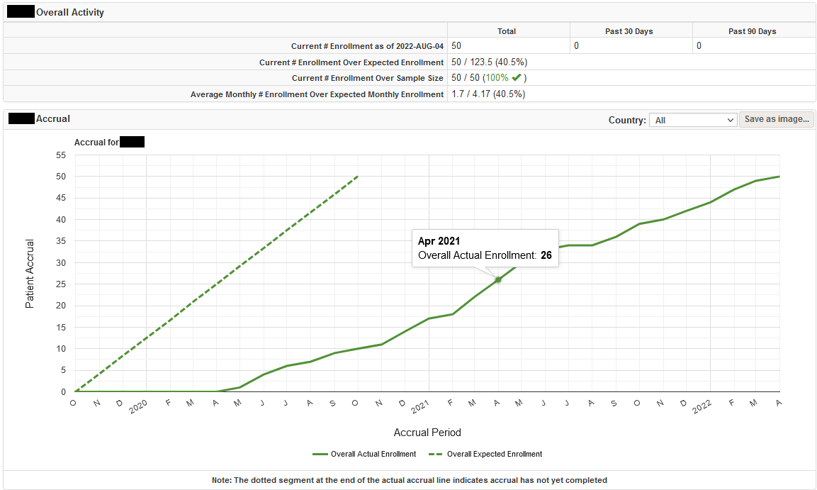
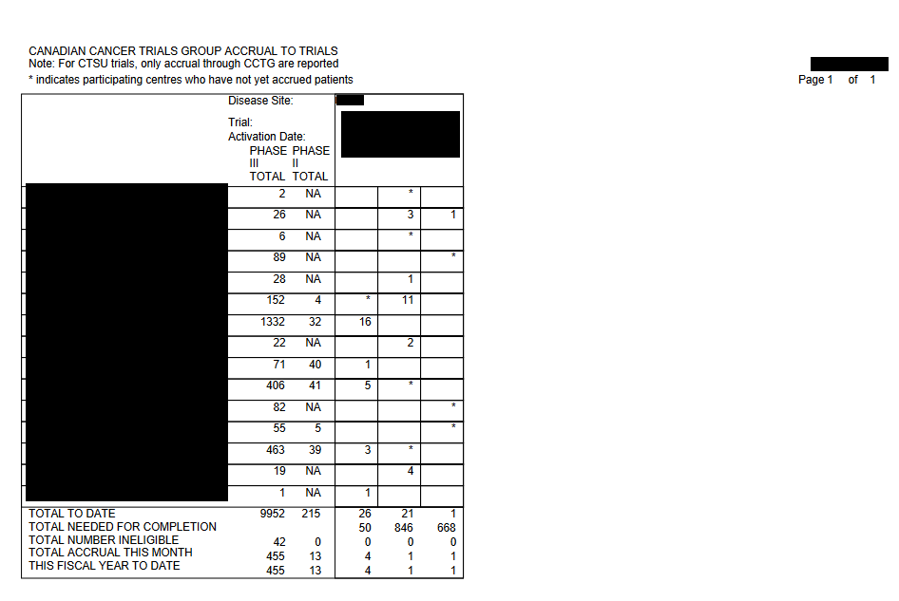
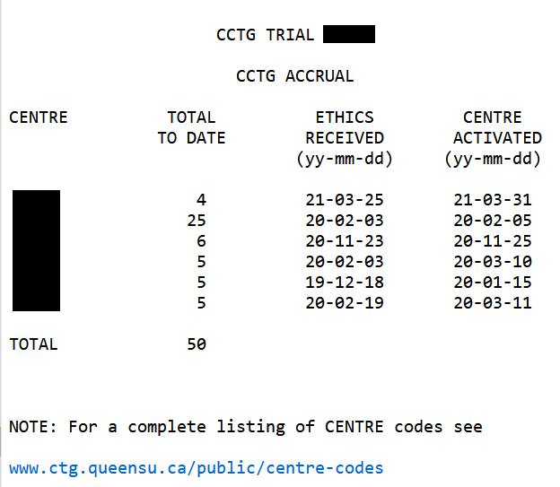
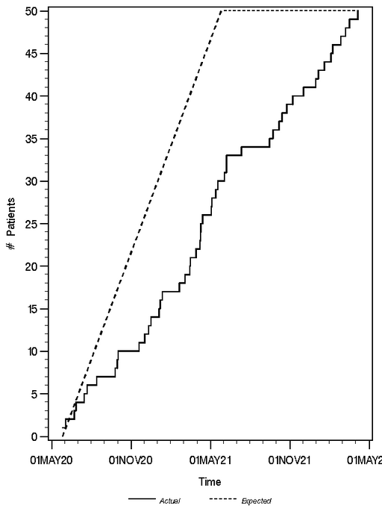
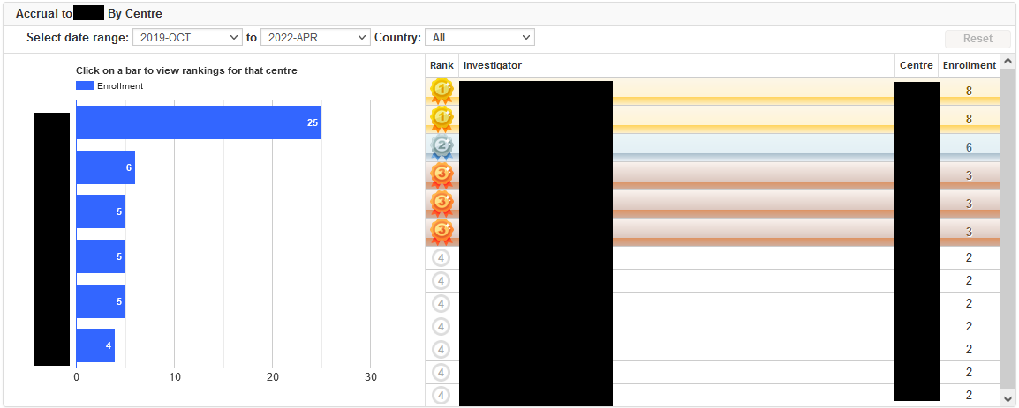
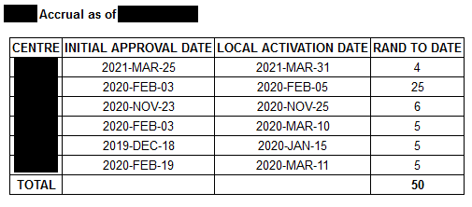
An Example of Data Analytics & Visualization Transformation: Accrual Utility
Accrual reports that are mostly tabular and static (not real-time)
Accrual Utility includes both tabular and visual representations of the same data (and more) that are interactive, dynamic, filterable, exportable with role-based access/permission
Future enhancement to extend across trials (e.g. by disease site), across centres (e.g. by country), including historic accrual data to give a broader scope

Slide 16
Summary
Increases in technological advances means more demand for IT resources, support and security
Systems and applications needs to keep up with current standards, trends, hardware/software requirements, devices and operating platforms, mobile technology
More data is being collected faster across different technologies; volume, velocity, variety
As a leader in innovation CCTG must continue to advance its technologies while maintaining commitments to quality, integrity and security

Slide 17
Questions?

Slide 18
Thank you

